Slide 1
Neurons for male mating in C. elegans
Nikhil Bhatla
January 16, 2013
MIT IAP

Slide 2
Mating in C. elegans
Wormbook.org

Slide 3
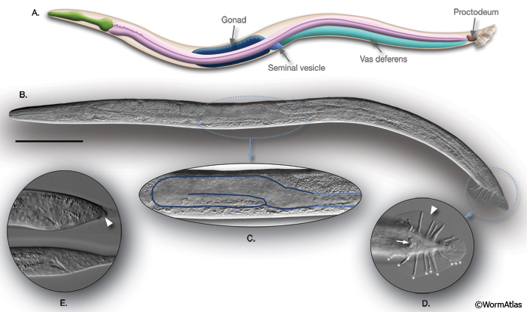
C. elegans hermaphrodites vs. males
Spermatheca
WormAtlas.org

Slide 4
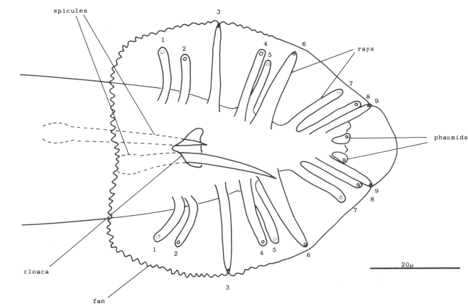
The male tail
PCS
spicules
rays
hook
cloaca
fan
Ventral view
WormAtlas.org

Slide 5
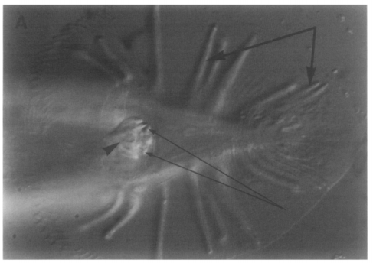
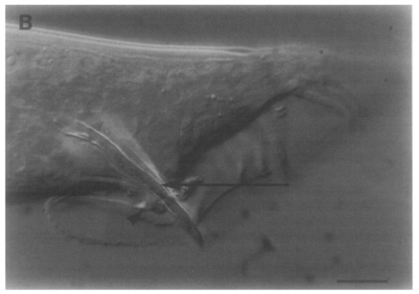
The male tail
rays
hook
spicules
PCS
hook
Ventral view
Side view
Liu & Sternberg 1995

Slide 6
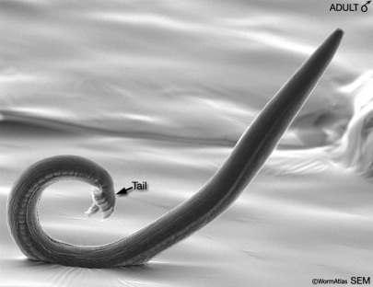
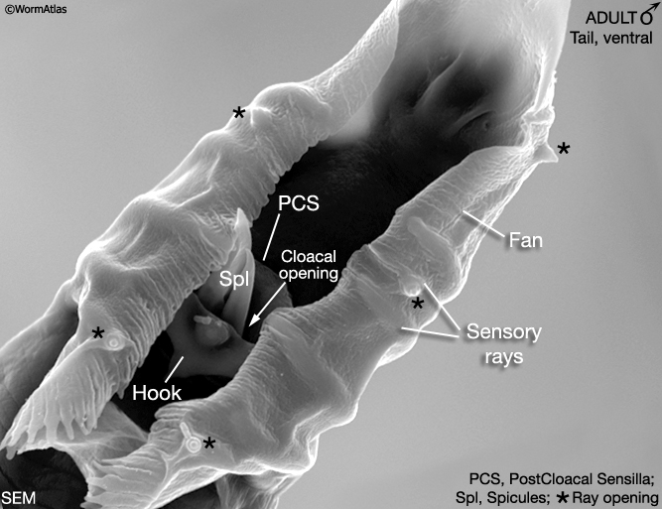
The male tail
WormAtlas.org

Slide 7
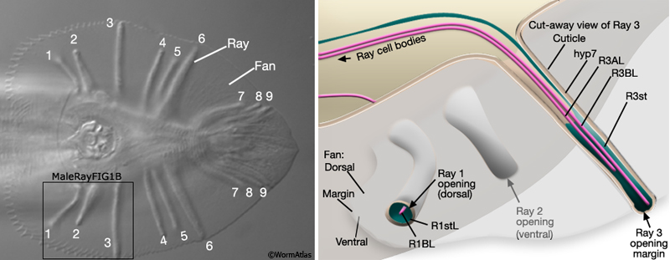
Sensilla are inervated by neural dendrites
WormAtlas.org

Slide 8
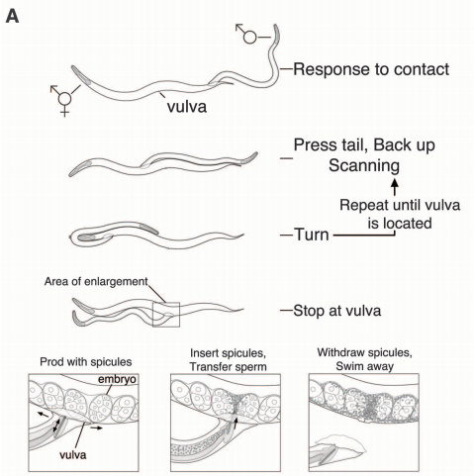
Steps in mating
Jarrells..Emmons 2012

Slide 9
Step #1: Males chemotax toward hermaphrodite-conditioned media
White..Jorgensen 2007

Slide 10
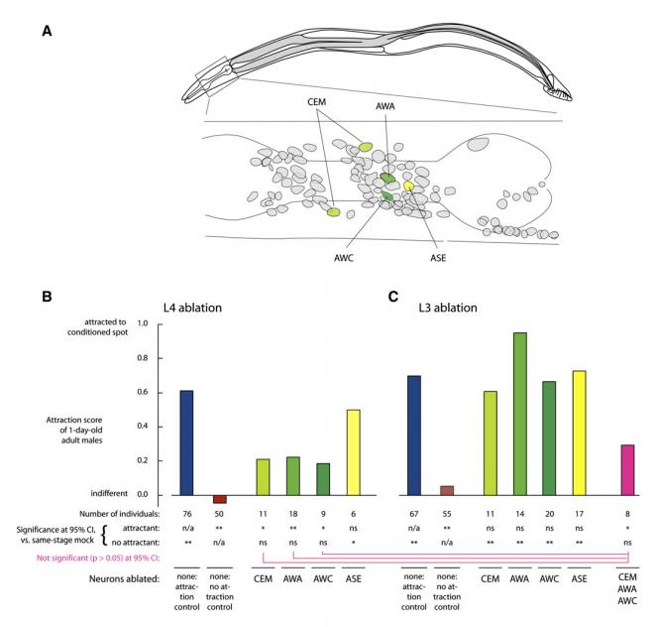
AWC, AWA & CEM are involved in male chemotaxis to hermaphrodite odors
White..Jorgensen 2007

Slide 11
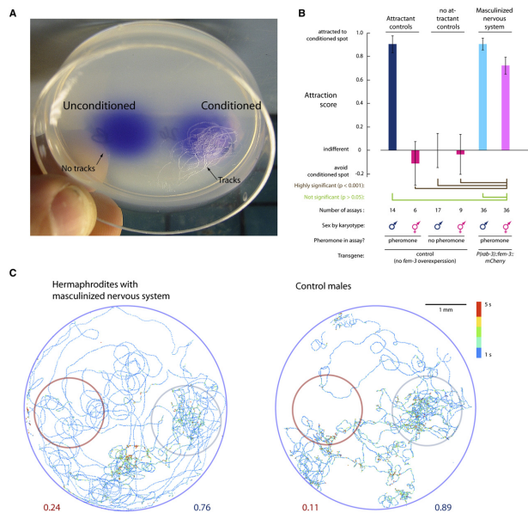
Hermaphrodites with a masculine nervous system are attracted to hermaphrodite odors
White..Jorgensen 2007

Slide 12
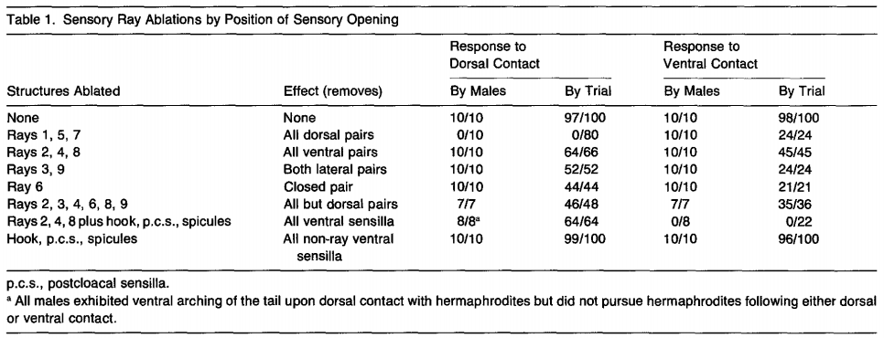
Step #2: Structures required for contact response
Liu & Sternberg 1995

Slide 13
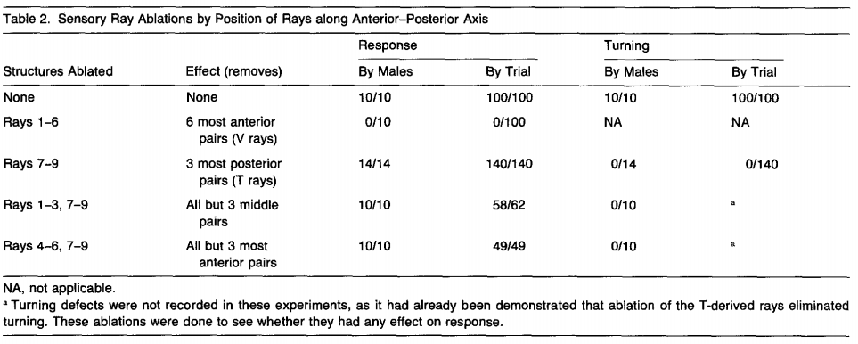
Steps #2 and #4: Structures required for contact response and turning
Liu & Sternberg 1995

Slide 14
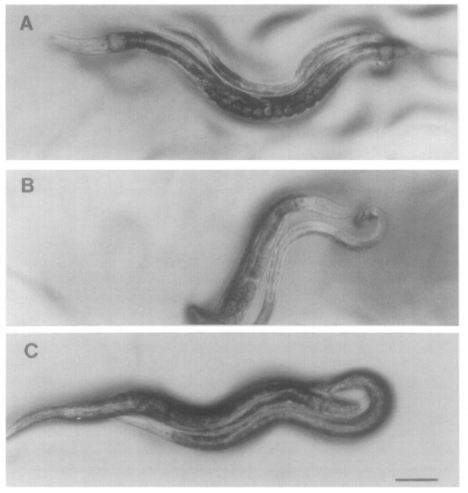
wild-type:
tight turn
Last 3 rays ablated:
late turn
Dopaminergic rays
(5A, 7A, 9A) ablated:
wide, sloppy turn
Liu & Sternberg 1995

Slide 15
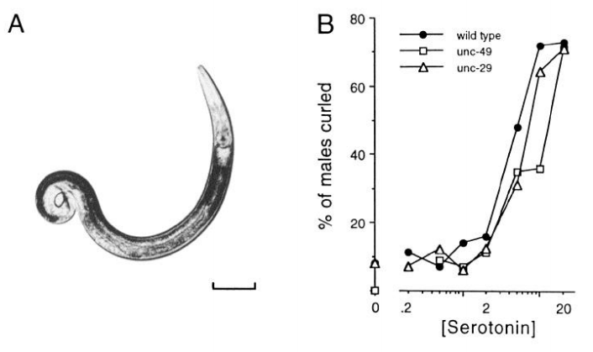
Exogenous serotonin induces ventral coiling, perhaps by directly contracting muscle
mM
Loer & Kenyon 1993

Slide 16
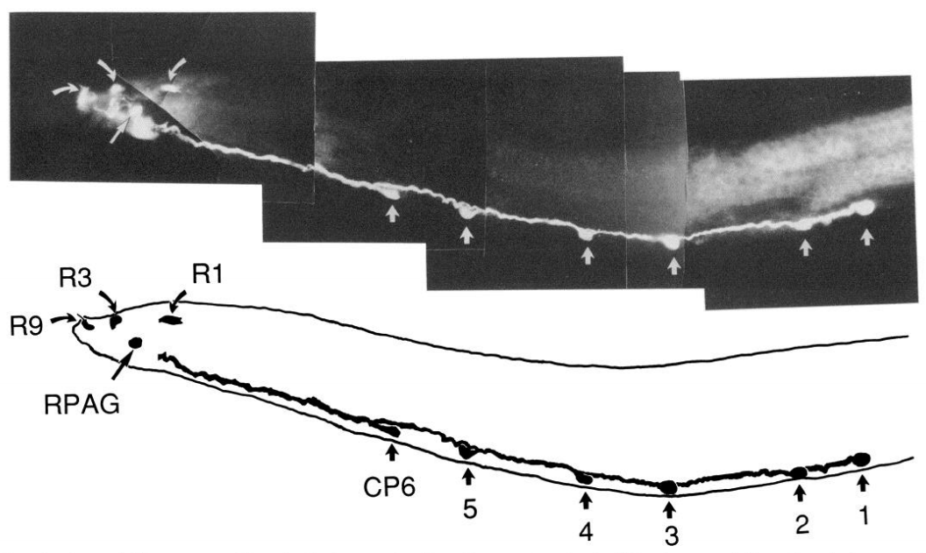
Serotonergic neurons in the male tail
Loer & Kenyon 1993

Slide 17
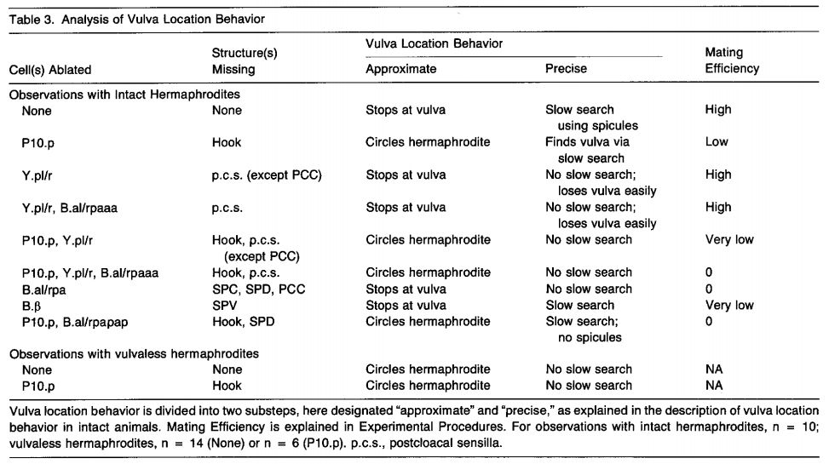
Step #5: Locate the vulva
Liu & Sternberg 1995

Slide 18
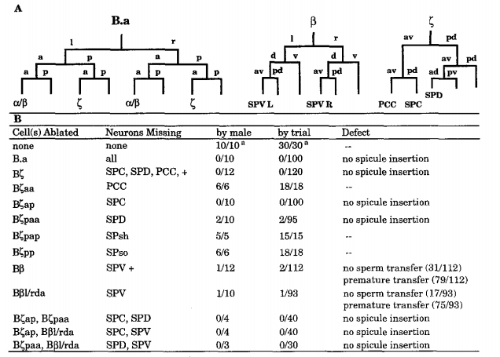
Steps #6 and #7: Insert spicule into vulva and ejaculate
Liu & Sternberg 1995

Slide 19
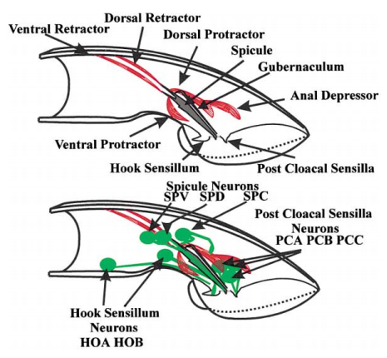
Muscle structure for spicule protraction
Garcia & Sternberg 2001

Slide 20
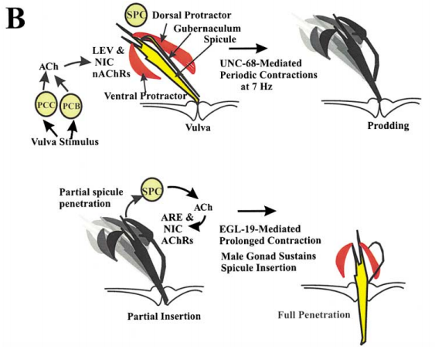
Steps for spicule insertion
Garcia & Sternberg 2001

